Slide 1
Lecture 5
Algorithm Analysis
Arne Kutzner
Hanyang University / Seoul Korea

Slide 2
Lower Bounds for Sorting

Slide 3
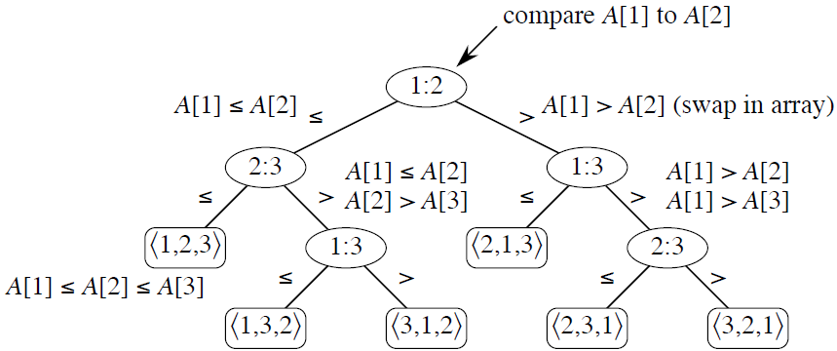
Decision-tree for insertion sort on 3 elements

Slide 4
Decision tree
Abstraction of any comparison sort.
Represents comparisons made by a specific sorting algorithm on inputs of a given size.
Abstracts away everything else:
control and data movement.
We are counting only comparisons.

Slide 5
Decision tree (cont.)
How many leaves on the decision tree? There are ≥ n! leaves, because every permutation appears at least once.
Q: What is the length of the longest path from root to leaf?
A: Depends on the algorithm. Examples
  Insertion sort: Θ(n²)
  Merge sort: Θ(n lg n)

Slide 6

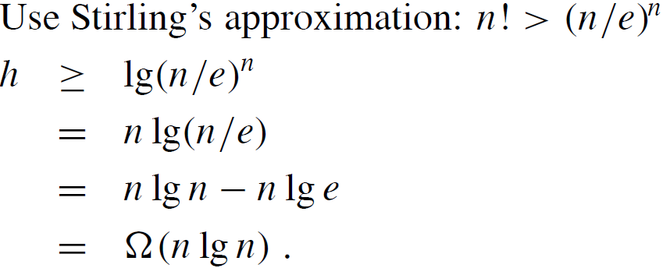
Decision tree (cont.)
Theorem Any decision tree that sorts n elements has height Ω(n lg n).
Proof: Take logs: h ≥ lg(n!)

Slide 7
Linear Time Sorting

Slide 8
Counting sort
Depends on a key assumption:
Numbers to be sorted are integers in
{0, 1, . . . , k}.
Input: A[1 . . n], where A[ j ] ∈ {0, 1, . . . , k} for j = 1, 2, . . . , n. Array A and values n and k are given as parameters.
Output: B[1 . . n], sorted. B is assumed to be already allocated and is given as a parameter.
Auxiliary storage: C[0 . . k]

Slide 9
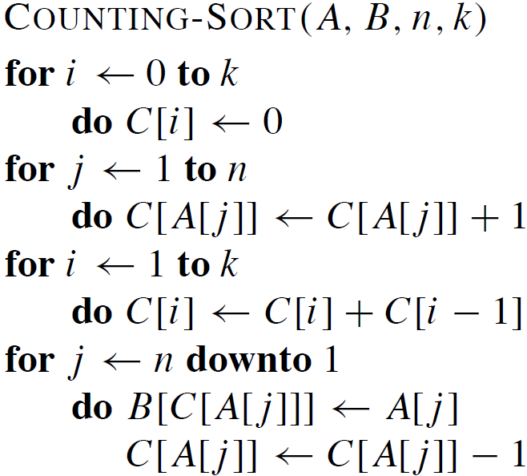
Counting sort - Pseudocode

Slide 10
Counting sort – Final Words
Counting sort is stable (keys with same value appear in same order in output as they did in input) because of how the last loop works.
Analysis:
Θ(n + k), which is Θ(n) if k = O(n).

Slide 11
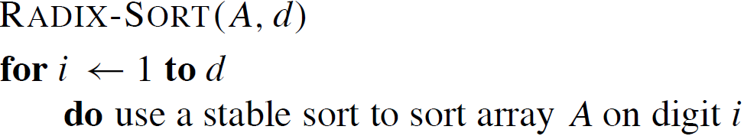
Radix Sort
Key idea:
Sort least significant digits first.
To sort numbers of d digits:

Slide 12
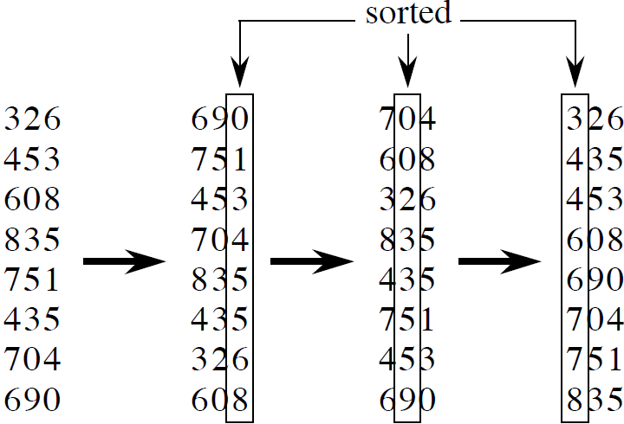
Example

Slide 13
Radix Sort - Correctness
Induction on number of passes (i in Pseudo code).
Assume digits 1, 2, . . . , i − 1 are sorted.
Show that a stable sort on digit i delivers some sorted result:
  If 2 digits in position i are different, ordering by position i is correct, and positions 1, . . . , i − 1 are irrelevant.
  If 2 digits in position i are equal, numbers are already in the right order (by inductive hypothesis). The stable sort on digit i leaves them in the right order.

Slide 14
Radix Sort Analysis
Assume that we use counting sort as the intermediate sort.
Θ(n + k) per pass
(digits in range 0, . . . , k)
d passes
Θ(d(n + k)) total
If k = O(n), time = Θ(dn).

Slide 15


How to break each key into digits?
n words.
b bits/word.
Break into r -bit digits. Have d =
Use counting sort, k = 2^{r} − 1.
Example: 32-bit words, 8-bit digits. b = 32,
r = 8, d = 32/8 = 4, k = 2⁸ − 1 = 255
Time =

Slide 16

How to choose r?
Balance b/r and n + 2^{r} .
Choosing r ≈ lg n gives us
If we choose r < lg n, then b/r > b/ lg n, and n + 2^{r} term doesn’t improve.
If we choose r > lg n, then n + 2^{r} term gets big.
Example: r = 2 lg n ⇒ 2^{r} = 2^{2 lgn} = (2^{lg n})² = n².

